Slide 1
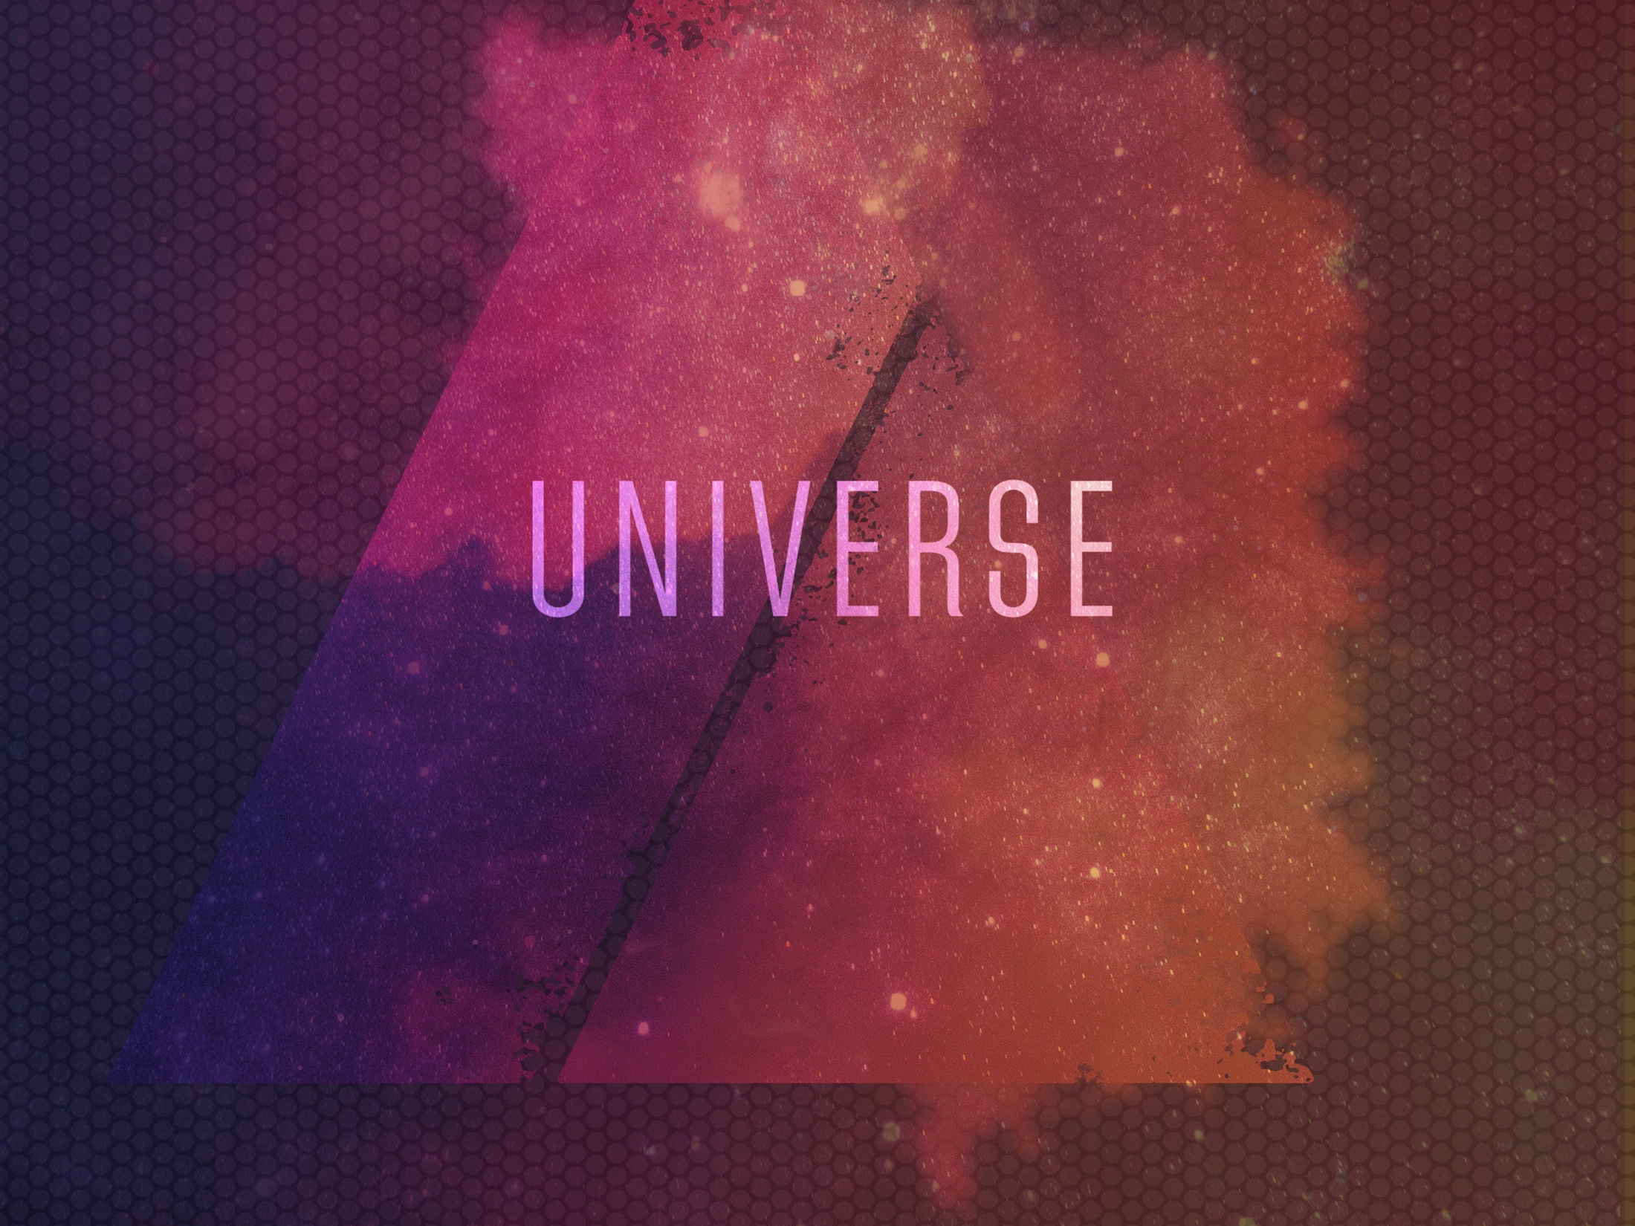
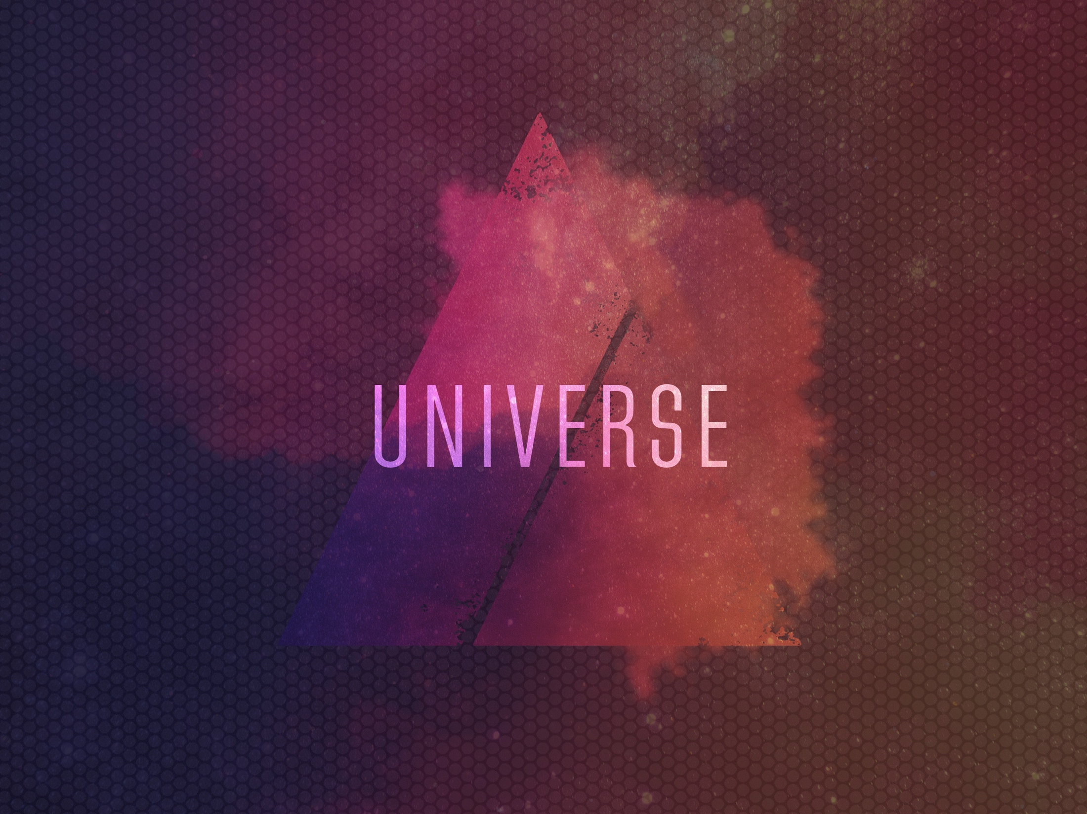
ESV

Slide 2

When I look at Your heavens, the work of Your fingers, the moon and the stars, which You have set in place, what is man that You are mindful of him, and the son of man that You care for him?
^{Psalm 8:3-4}
ESV

Slide 3
The physical laws that govern our universe can be explained through purely natural means.
ESV

Slide 4
The fine-tuning of the universe is one evidence from nature that points toward a designer.
ESV

Slide 5
TEMPLATE
•
•
•
ESV

